Slide 1

LAB INFRASTRUCTURE BILLING SYSTEM
Presented by:
Suraj Singh (20104032)
Himanshu Rane (201040
Atharva Takle (20104022)
Project Guide
Prof. Vishal Badgujar

Slide 2
Content
Introduction
Objectives
Scope
Features/ Functionality
Project Outcome
Software Stack
ER- Model
Implementation
Conclusion/Summary
References

Slide 3
Introduction
Lab infrastructure billing system is an executive information system (EIS) that determines the bill of each lab infrastructure.
It provides an environment to maintain the bills of components used in lab.
Problem Identified:
Maintaining large no. of bills register.
Generating purchase report
Maintaining and accessing purchase product details.
Solution:
A user can easily access the purchase product details.
The scanned bills of each component can be stored in the system with that component details.
Records are able to maintain more efficiently.
And it is efficient way to store data and also the data can be recover anytime anywhere.

Slide 4
Objectives
To segregate lab category, year of purchase with their unique identification.
To create a dashboard with department wise segregation of lab and total number of labs.
To provide a interface for user to store scanned copy of bills in pdf format.
To enable user to print bills and statistics.

Slide 5
Scope
Can be applied in Labs, industries, Colleges, Schools etc.
Useful for the Lab In charge, employees etc.

Slide 6
Features/ functionality
Sign in/ Sign up/ Forget password
Sign in and Sign up helps user to register and login themselves which gives a security to the user by preventing unauthorized actions and thus protects the data. If user Forget password they able to change password.
Dashboard
Combo boxes are added n the dashboard which makes it easier for the user to select the lab, department and year through which they can view or edit the data according to their convince.
A User can able to upload the bills of the purchase components with their details and later the user can able to print uploaded bills.
Profile
A user can access his/her profile and activities.

Slide 7
Outcomes
User can able to login & Signup if in case user forget their password then they can change their password too.
User will able to access their profile page.
User can able to maintain the records of bills of their Lab infrastructure.
Price of every component purchased in different years are available with their scanned copy of bills in pdf format.
The uploaded bills can be printed later when they are required.
Only Registered Users can view or edit the data. Thus providing protection to the data.

Slide 8
Software Stack
Development: Eclipse IDE 2021-09 (4.21.0)
Front End (GUI): JAVA Swing
Back end (Database): PostgreSQL (12.9-111)

Slide 9
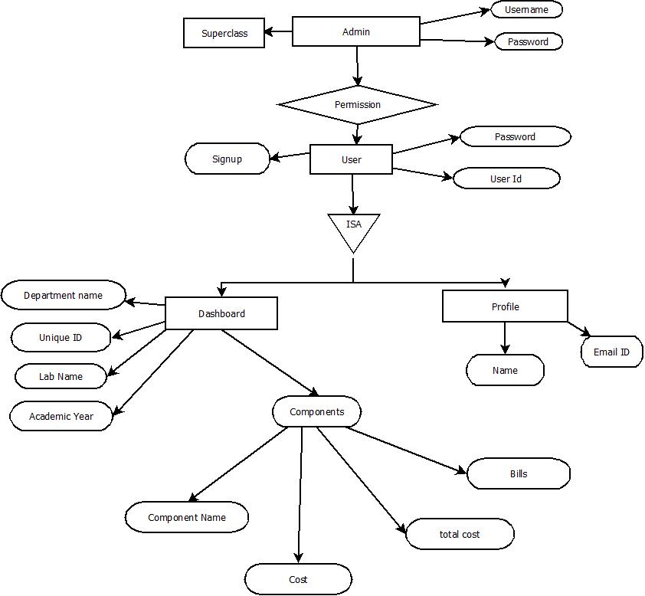
ER- Model

Slide 10
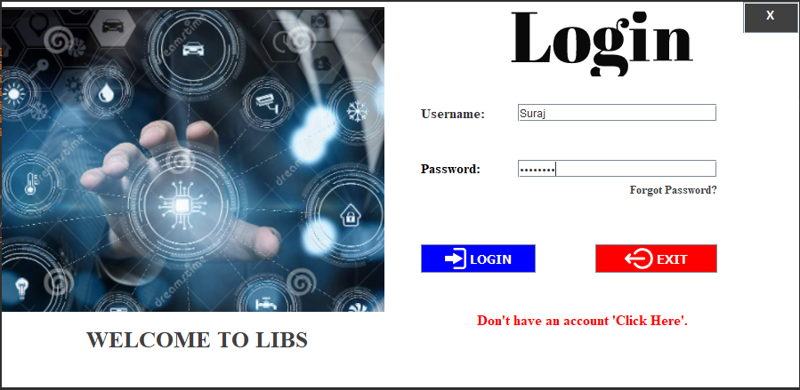
IMPLEMENTATION

Slide 11
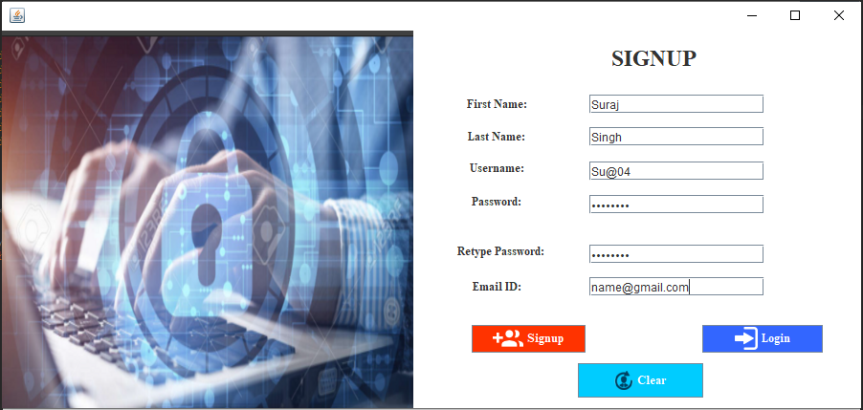
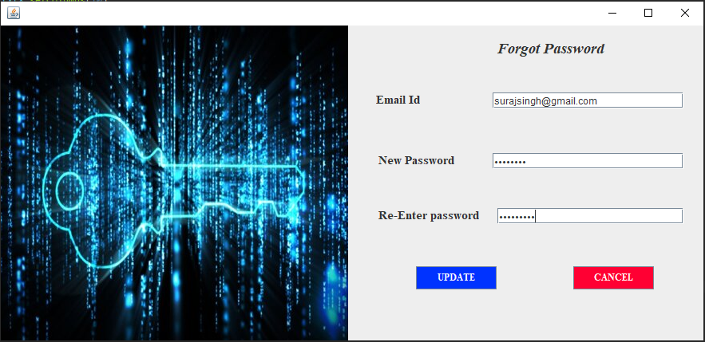

Slide 12
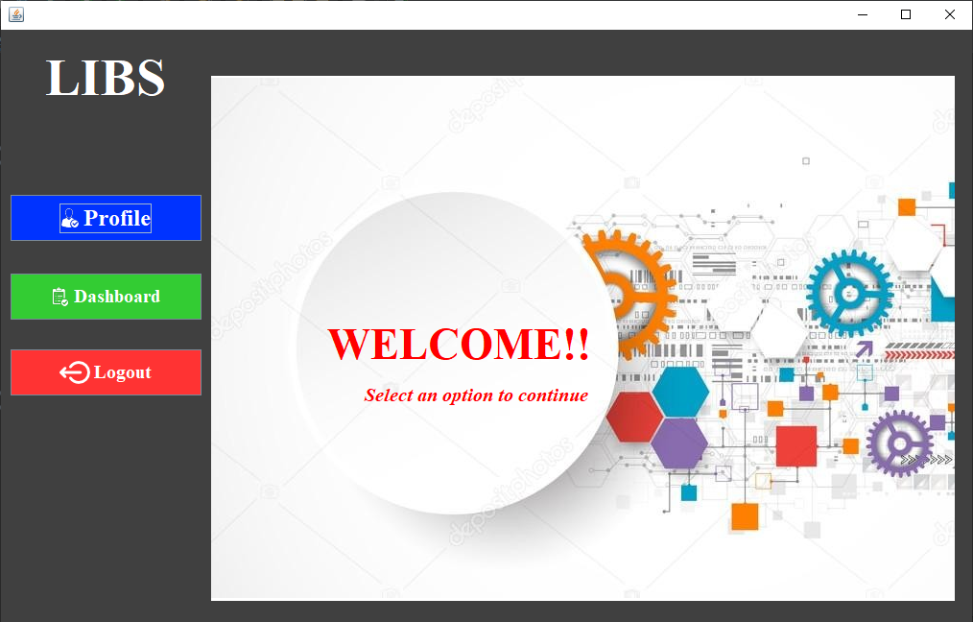

Slide 13
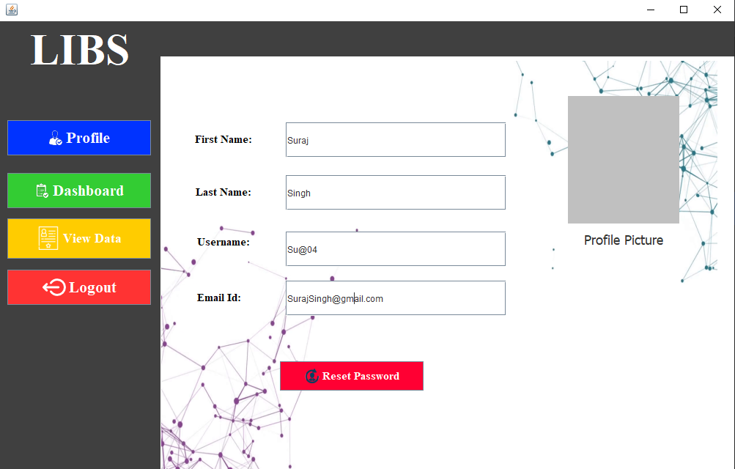
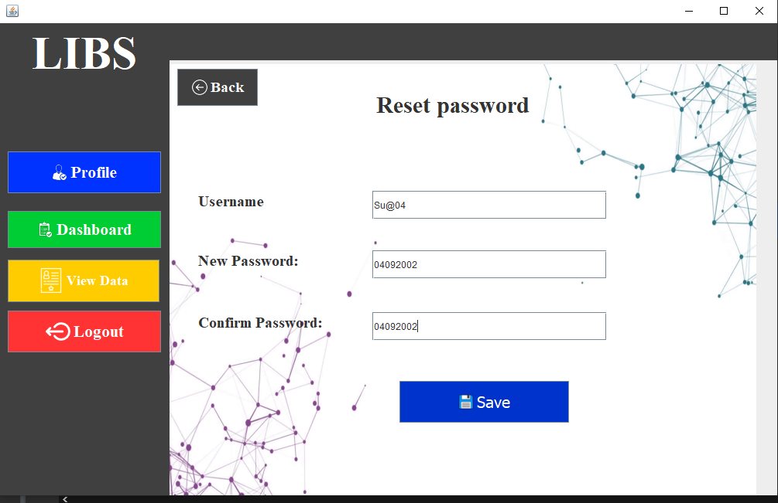

Slide 14
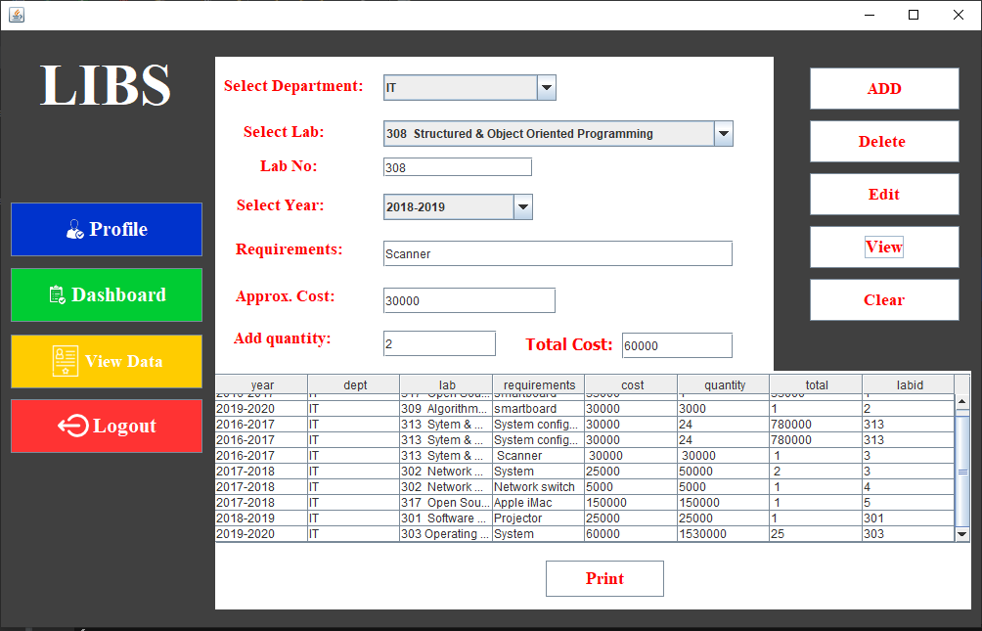

Slide 15
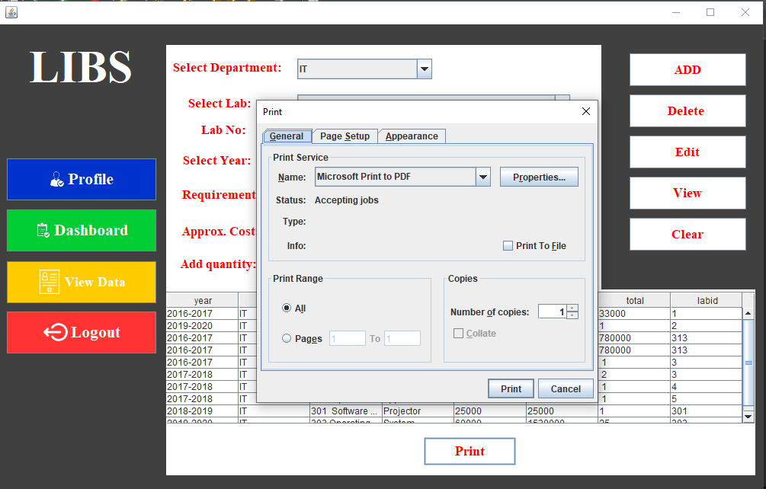

Slide 16
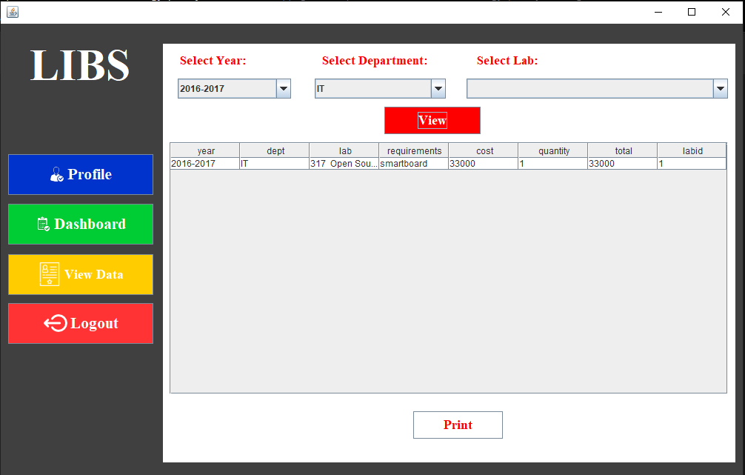

Slide 17
Conclusion
Our project is only a humble venture to satisfy the needs of the user. Several user friendly techniques like Drop down boxes, Reset password Option, print Option and many more features are added. The objective of the project is to propose a system that will record and maintain data of the Lab Infrastructure. This reduces the burden of lab employees as they don’t have to spend time on maintaining and then storing the data. This reduces their effort and saves time.
Manually maintained and stored data has many faults like repetition of same data, entering wrong data or sometimes loss of data. In our project, we have overcome these problems and lead to an errorless system. Also if one has to view data, He / She has to go through a number of registers or books. In our Project we have solved this issue by adding View Option. In future work we are trying to add security features for the same.

Slide 18
References
Herbert Schildt, “Java-The Complete Reference”, Tenth Edition, Oracle Press, Tata McGraw Hill Education.
Head First Java: A Brain-Friendly Guide, 2nd Edition https://drive.google.com/drive/folders/1OfmqJY6V7hE-kfj95tuMzAoevfKomEeQ
Korth, Slberchatz, Sudarshan, Database System Concepts, 6th Edition, McGraw Hill
https://drive.google.com/drive/folders/13jZzBtrqfLzXH_t2bROpcMxjOkR3vnvC
https://www.wikipedia.org/
https://www.postgresqltutorial.com/

Slide 19
Thank You..!!

